Slide 1
C Groups and Name Space

Slide 2

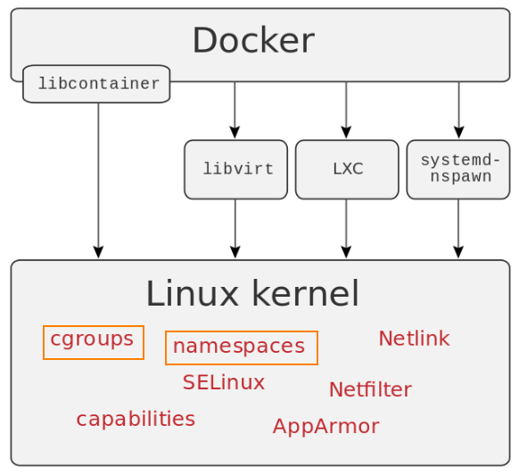
Why C Groups and Namespace

Slide 3
C Group ?
cgroups, short for control groups, allow kernel imposed isolation on resources like memory and CPU.
Control group has sub systems aka system ⁠represents a single resource, such as CPU time or memory
Hierarchy: A set of subsystems mounted together forms a hierarchy. Tasks : The system processes are called tasks in cgroups terminology. Cgroups : A cgroup associates a set of tasks with a set of parameters for one or more subsystems.

Slide 4
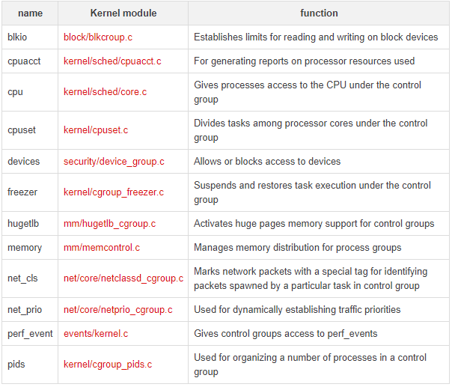
C Group Subsystems Implementation

Slide 5
C Group – Hands On
Hands On:
Checking the C Groups directory structure
Setting the memory restriction for a process in C Group

Slide 6
Container FS and chroot (w/0 Docker)
Container are usually a tar ball containing the FS
Once Can literally navigate through the file system
In order to check the view for the container FS, chroot tool is used.
4. Hands On

Slide 7
Namespace
Containers ensure isolation through namespaces.
Provides restricted view. Eg: restricted view of process tree.
There is implementation for creating NS:
- unshare() : Create NS and attaches current process to NS
- clone() - Create NS and process and attach process to NS,
- Setns() - joining an existing namespace to an existing process
Hands On - Name Space

Slide 8
Thank You

